Slide 1
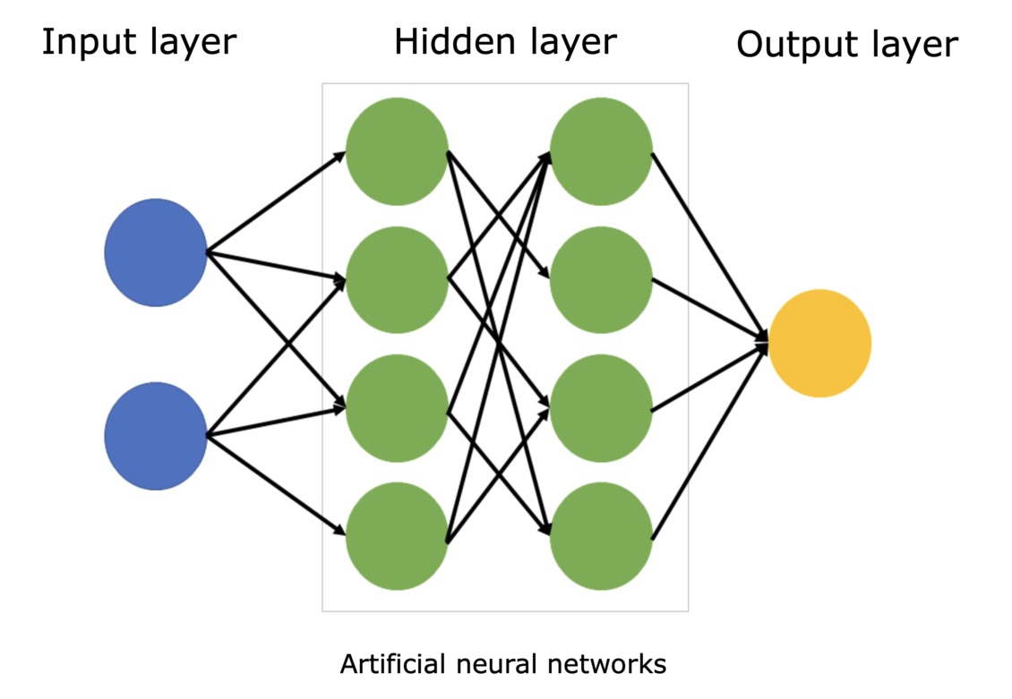
Advanced Artifact Usage: Animations
Notes:
Can you turn this into a simple react animation so I can understand it better
Give it much more detail and layers so I know what is going on at each phase and indicate any types of calculations that could happen be generous with your labels for understanding

Slide 2
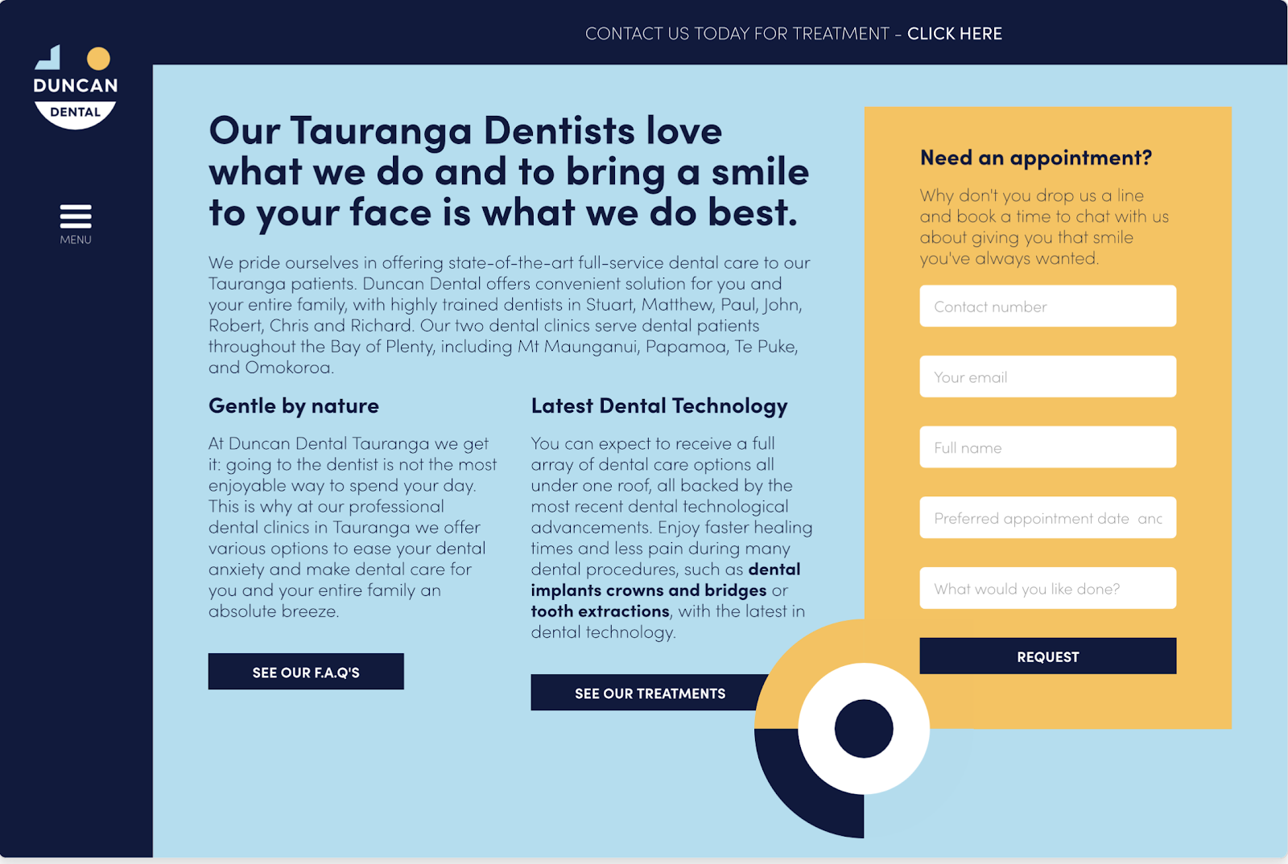
Advanced Artifact Usage: UX Design
Notes:
https://webflow.com/blog/ux-design-examples
Can you recreate this in react for my company called "Dental King"?
Can you make it look more like the picture I gave you?

Slide 3
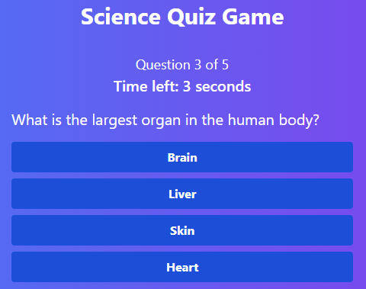
Advanced Artifact Usage: Games
Notes:
Can you create a game for me to play? I'm bored and I love science.

Slide 4
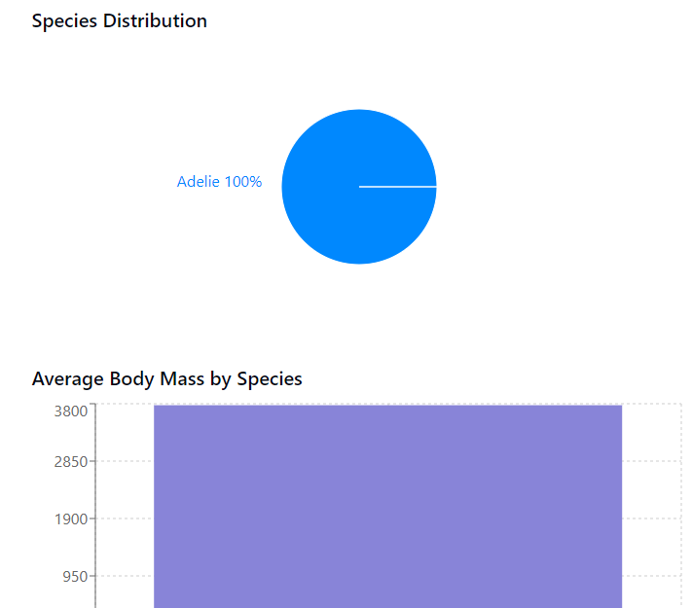
Advanced Artifact Usage: Data Visualization
Notes:
Can you turn this data into JSON and then use it in a react page to visualize the data in a variety of ways?
Use only basic components that don't need an install
Only use components that you support in artifacts
Can you turn this data into JSON and then use it in a react page to visualize the data in a scatter plot without installing additional components?

Slide 5
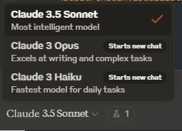
Changing Models

Slide 6
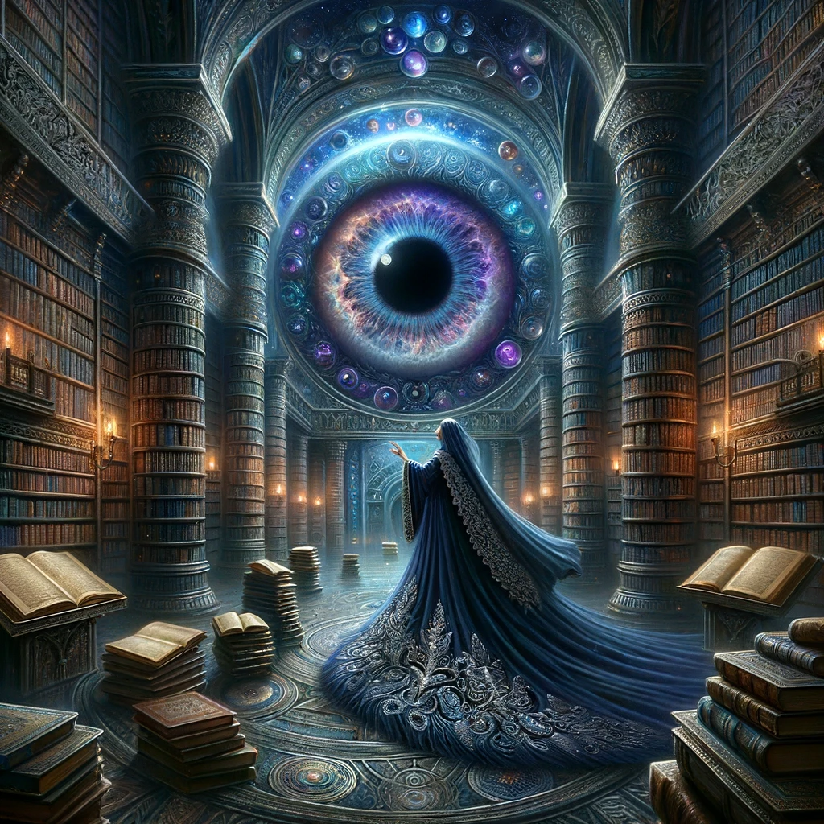
Vision

Slide 7
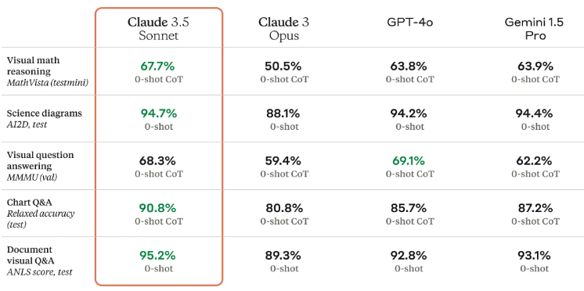
Notes:
https://www.anthropic.com/news/claude-3-5-sonnet

Slide 8
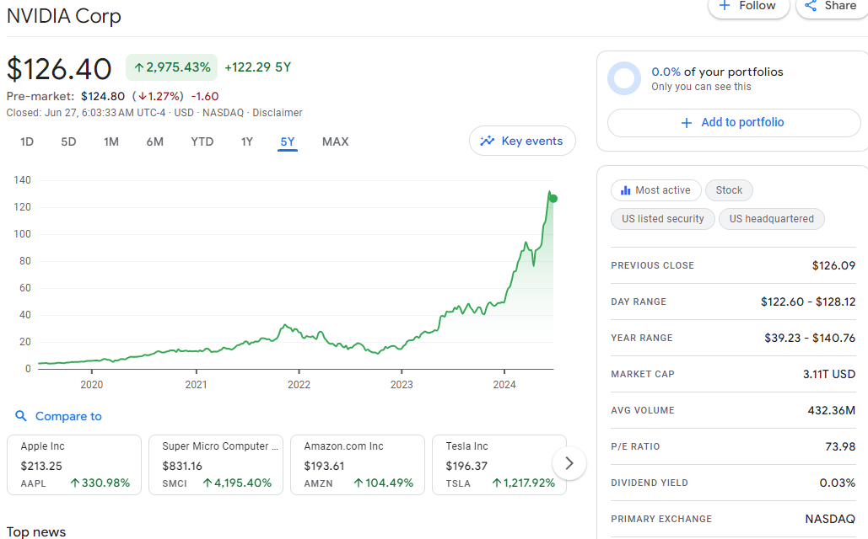
Graphs
Notes:
Is this stock a good buy?

Slide 9
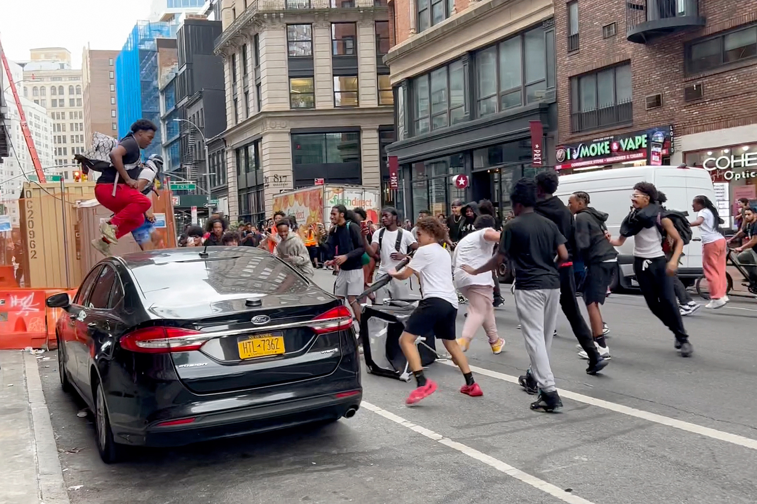
Identification
Notes:
Where is this located at?

Slide 10
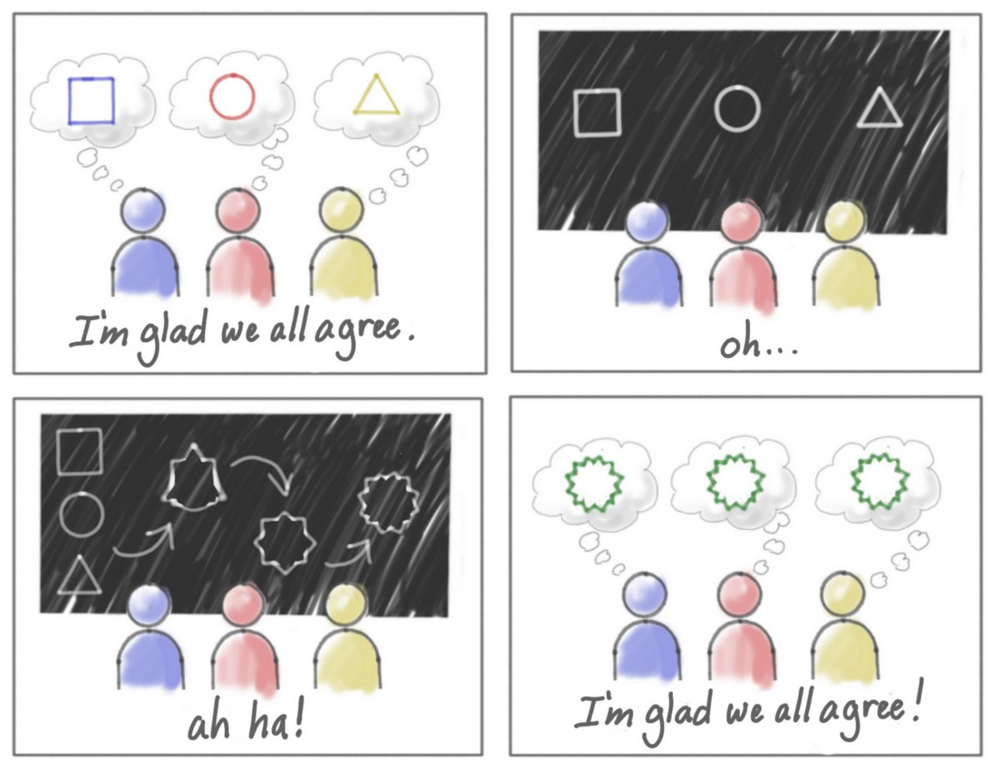
Abstract Ideas
Notes:
What is going on here?

Slide 11
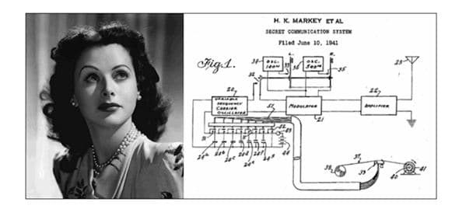
Relationships
Notes:
How are these related?

Slide 12
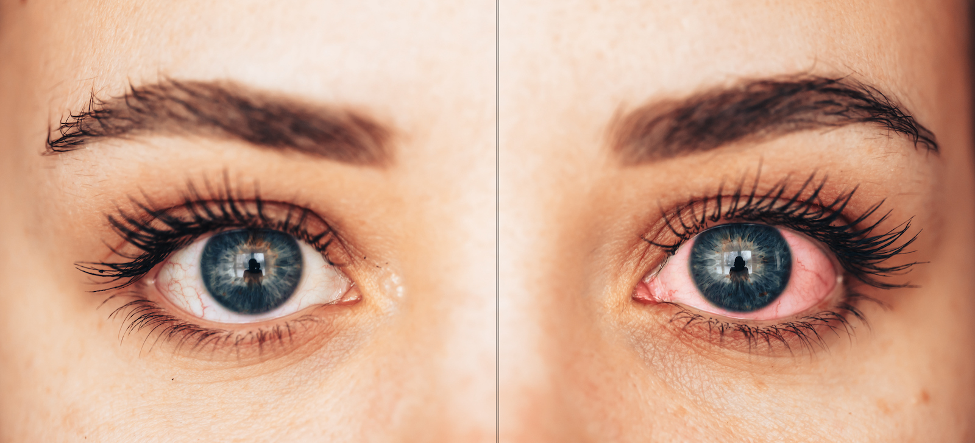
Medical
Notes:
What is this?

Slide 13
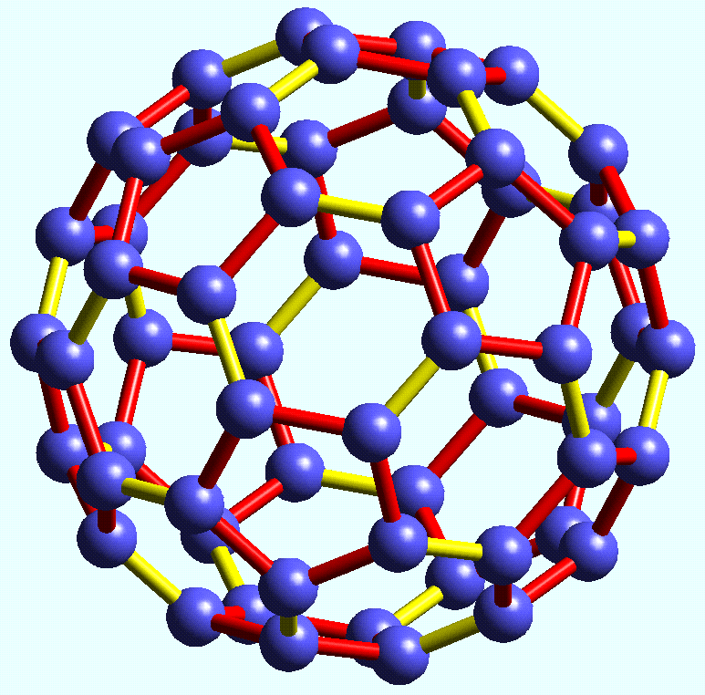
Chemistry
Notes:
What is this?

Slide 14
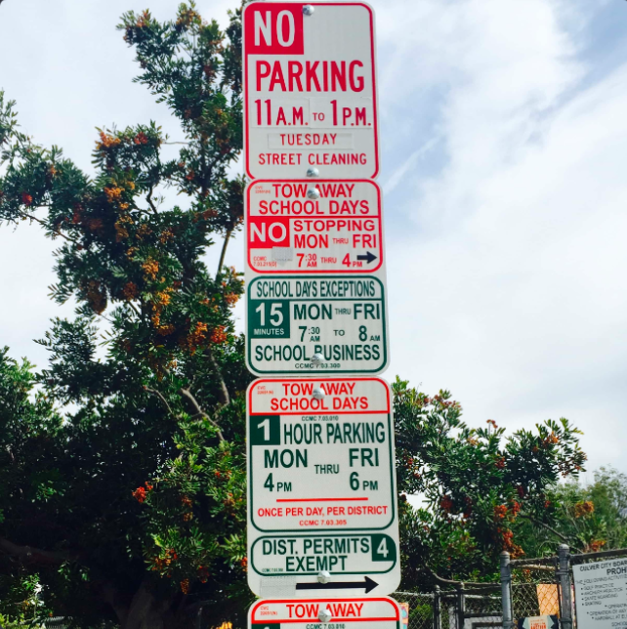
Parking
Notes:
It’s 7:45am on Tuesday, can I park here?

Slide 15
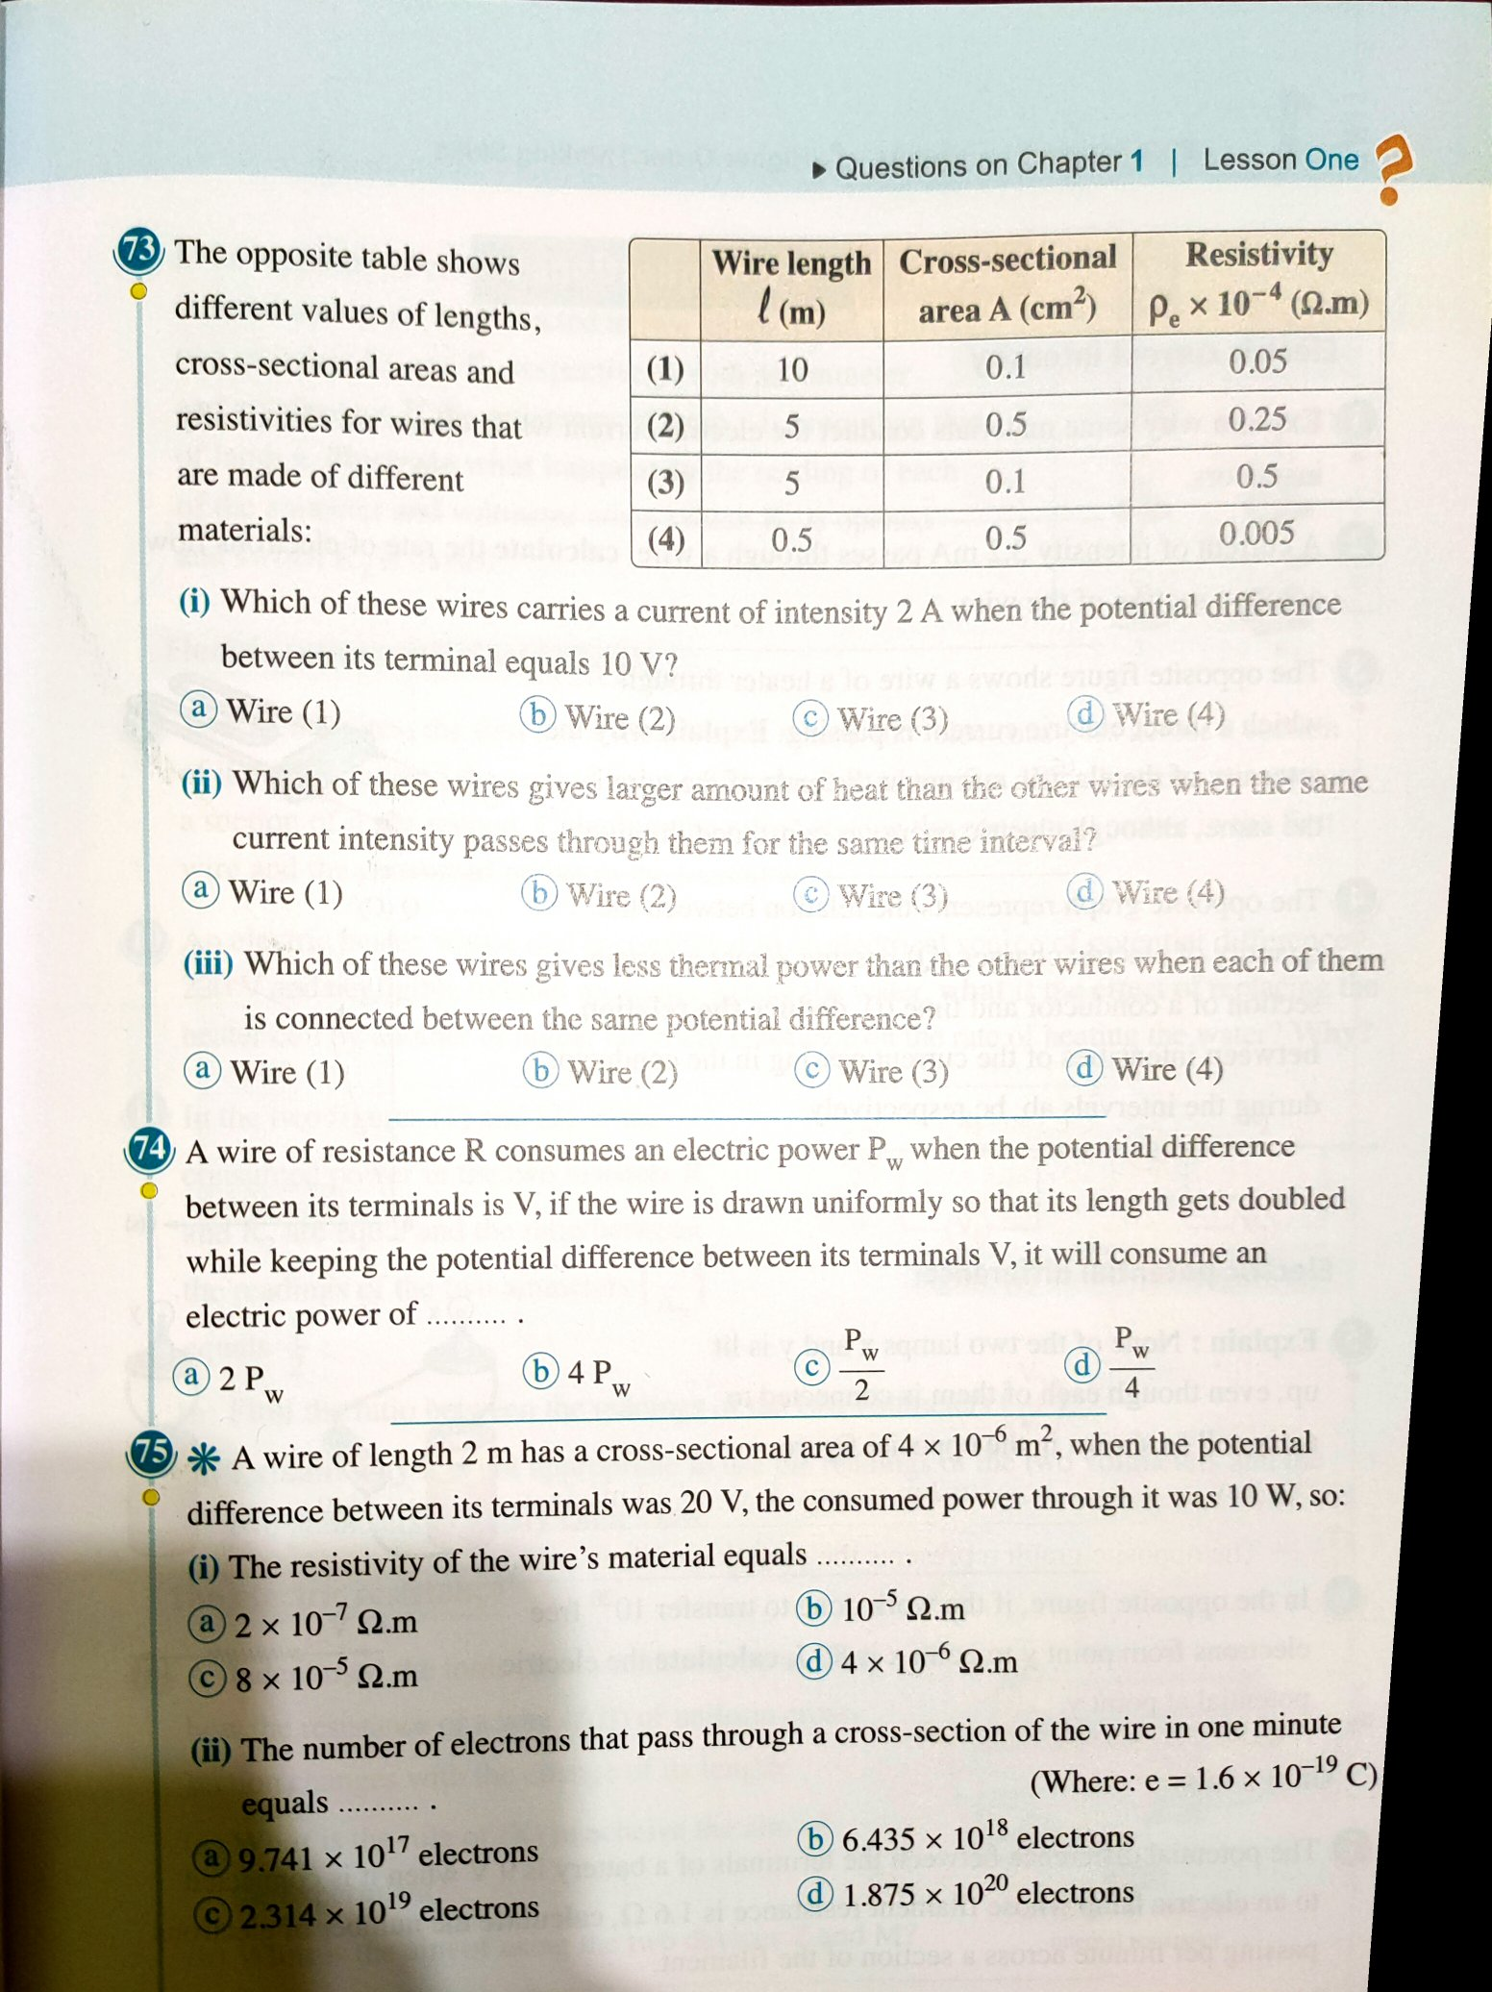
Homework
Notes:
Can you answer these questions?

Slide 16
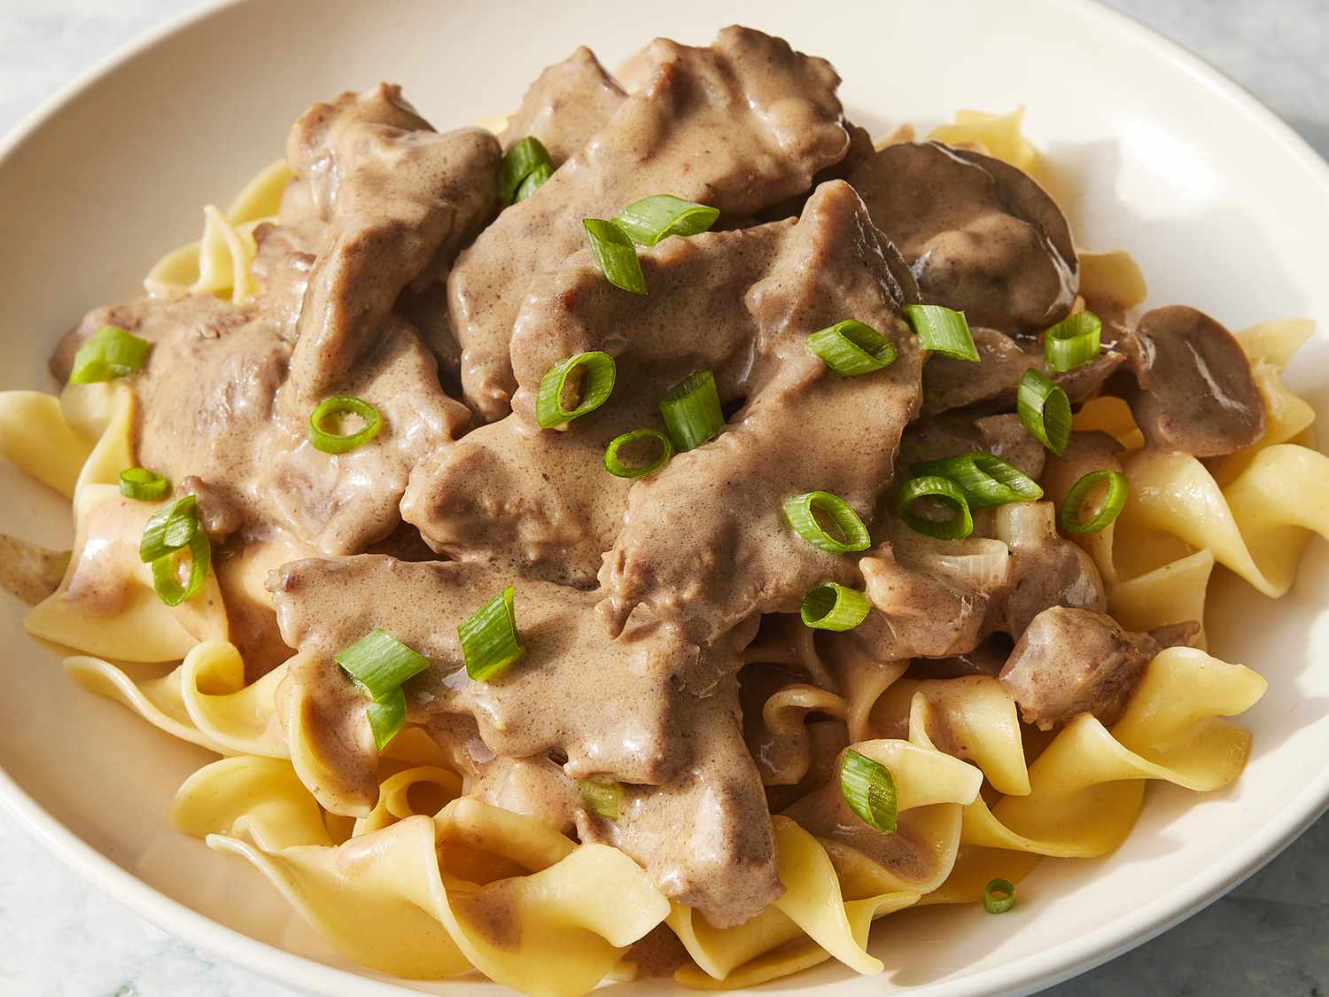
Cooking
Notes:
What is this and how do I make it?

Slide 17
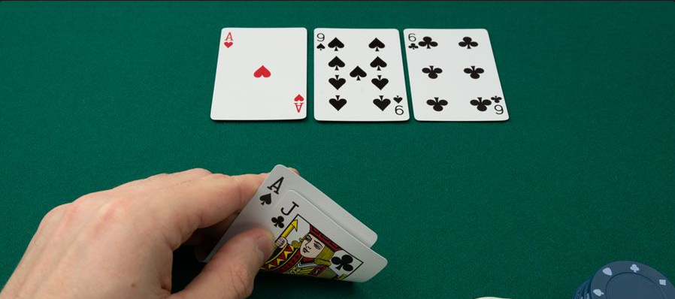
games
Notes:
What is the best hand I can make here?

Slide 18
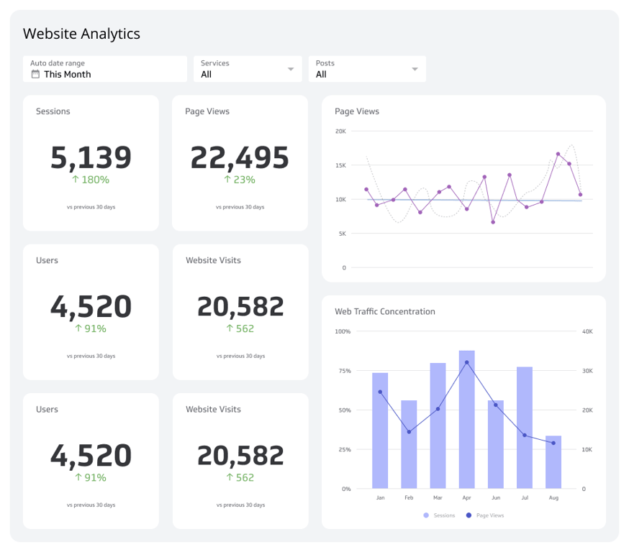
Code
Notes:
Give me HTML, CSS, and JavaScript code to recreate this dashboard.

